Slide 1
GOOD LIGHT FOR WORKING
Lab Training Embedded Systems SS2019
4 July, 2019
Presented By:
Manraj Singh
Tanvi Singh
Saqib Nawaz

Slide 2
TABLE OF CONTENTS
TASK PURPOSE
HARDWARE REQUIREMENTS
DESIGN
IMPLEMENTATION
DEMONSTRATION

Slide 3

PURPOSE
Low Light intensity in room.
Light Sensor detects the light intensity.
Prompt user to increase the light intensity.
Lock PC if still low light intensity after warning.
Fig: Dizzion

Slide 4
HARDWARE REQUIREMENTS
Arduino Leonardo Board with USB connector
Breadboard
PC
LDR(Light-Dependent Resistor)/Photocell
220 ohm resistor x 1
Jumper wires x 5

Slide 5
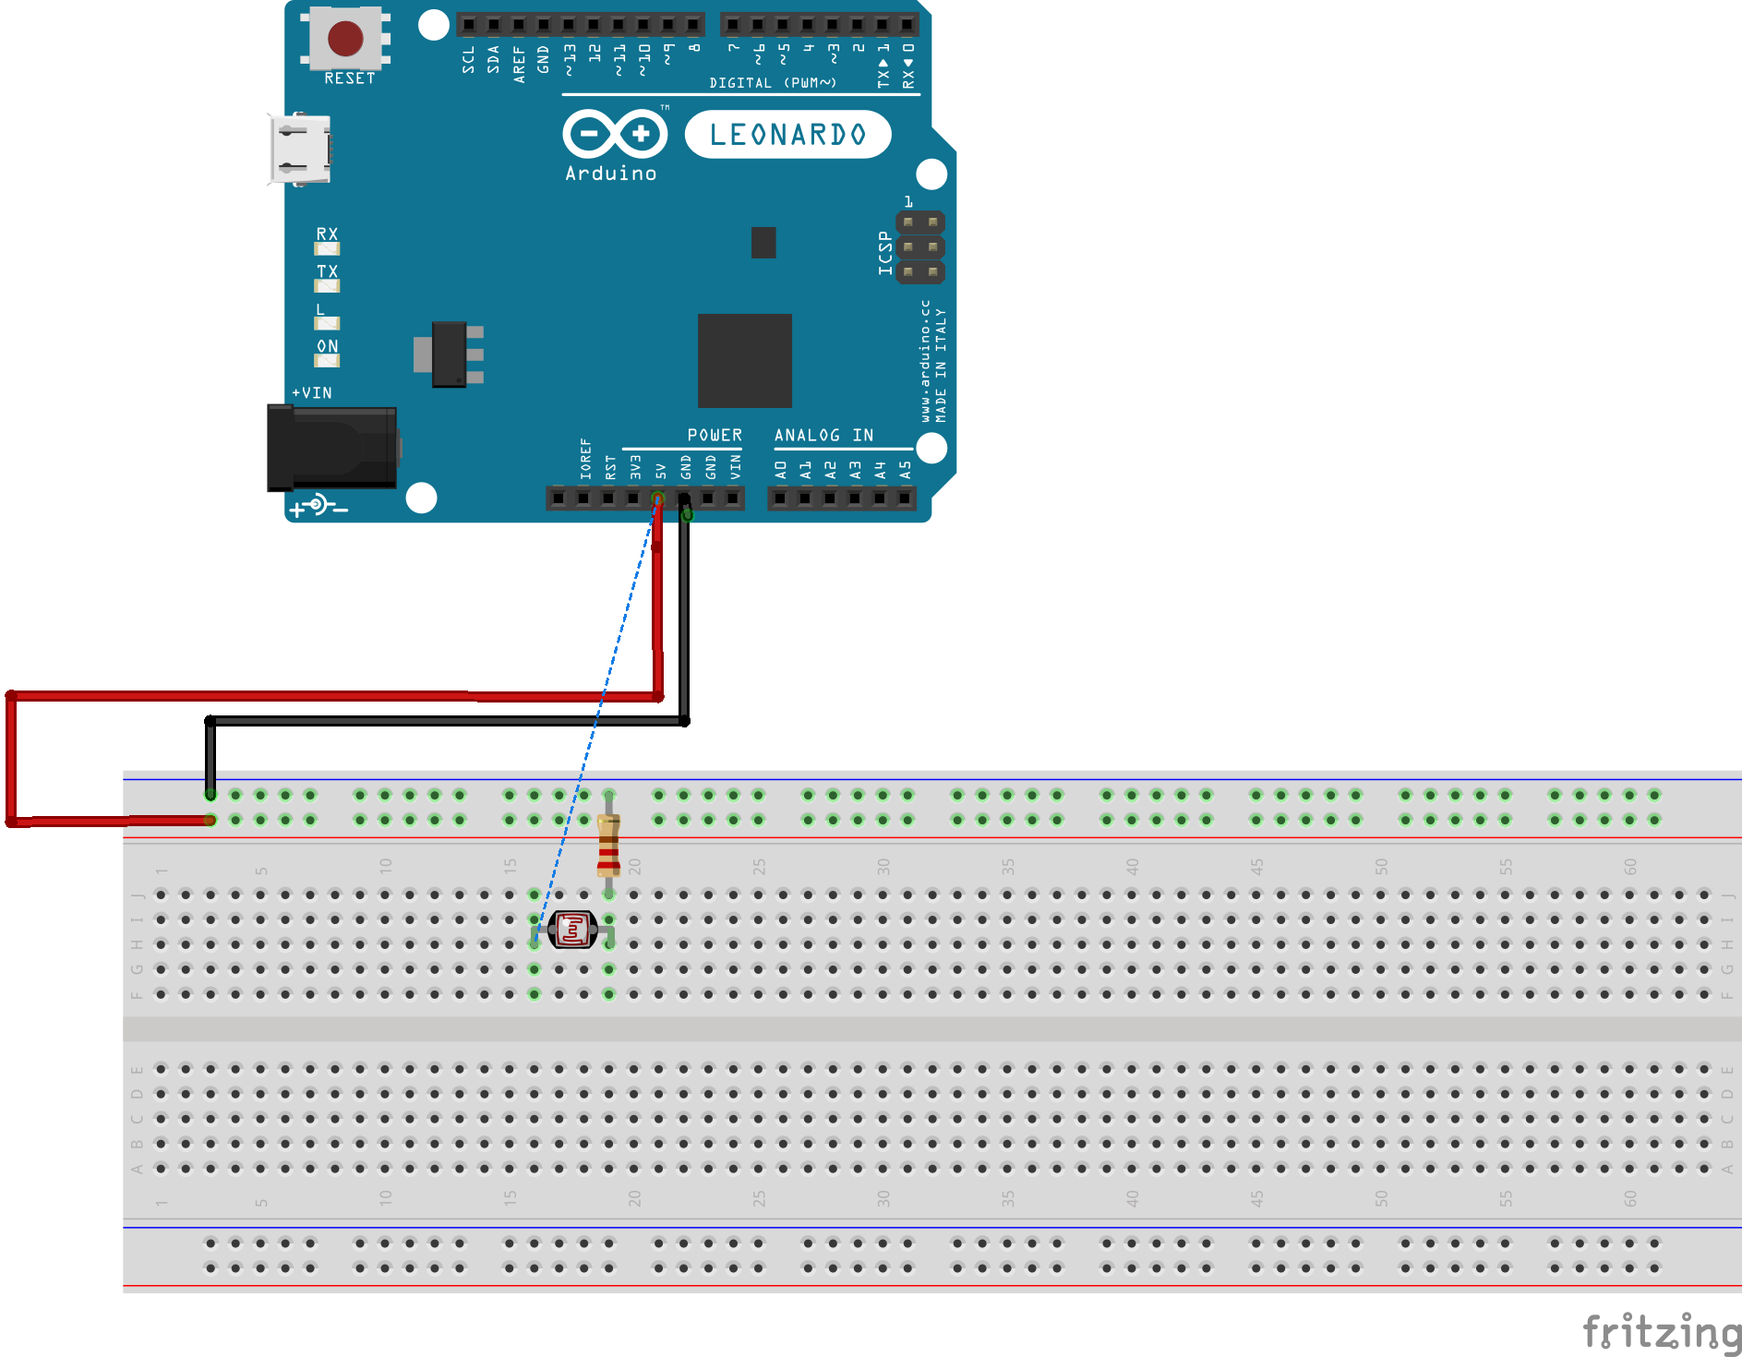
DESIGN

Slide 6
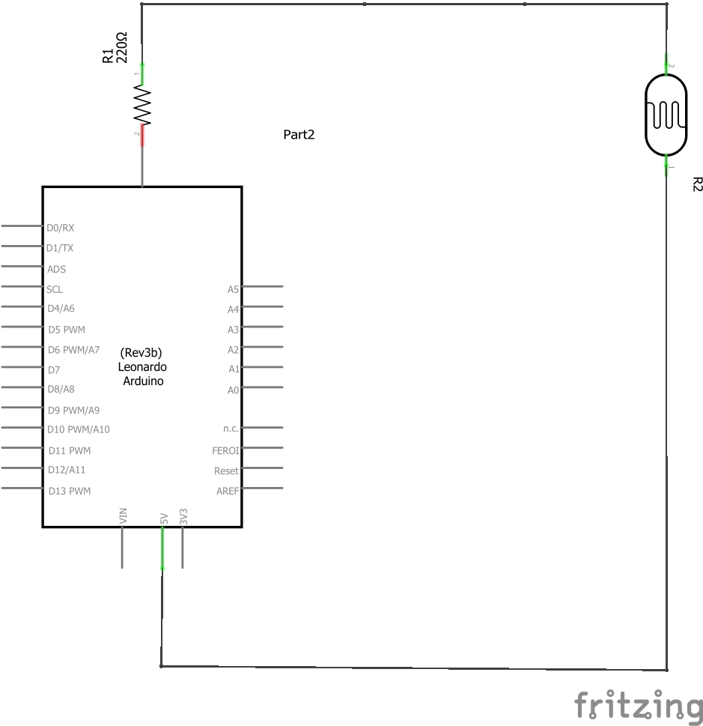
DESIGN

Slide 7
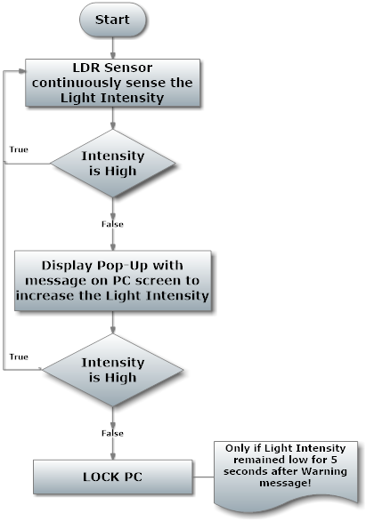
IMPLEMENTATION

Slide 8
DEMONSTRATION

Slide 9
THANK YOU
https://github.com/TanviSingh01/Good-Light-For-Working

